Slide 1
Exercise 1: SVD and its properties
Data:
Step 1: Generate two random matrices: A = randn(1000,2); B = randn(200,2);
Step 2: Construct matrix X = A*B’ + noise, i.e., where noise is =0.1*randn(1000,200)
What is the rank of X?
Plot the singular values of X
Is X low-rank?
What is the best rank-2 approximation of X?
Compute what percent of the “energy” is explained using the best rank-2 approx.
Plot the significant left and right singular vectors.

Slide 2
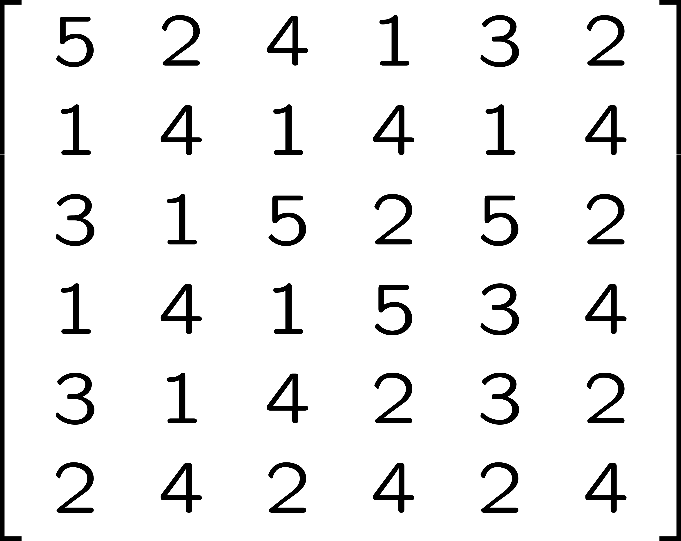
Exercise 2: Recommender Systems
Given the following user-movie rating matrix, can you group users based on
their interests in movies? Which groups of users are interested in what type of movies?
Hunger Games
Maze Runner
American Pie
Silver Linings
load exercise2_usermovie.mat
Compute its SVD
Star Wars
Aloha
User 1
User 2
User 3
User 4
User 5
User 6

Slide 3
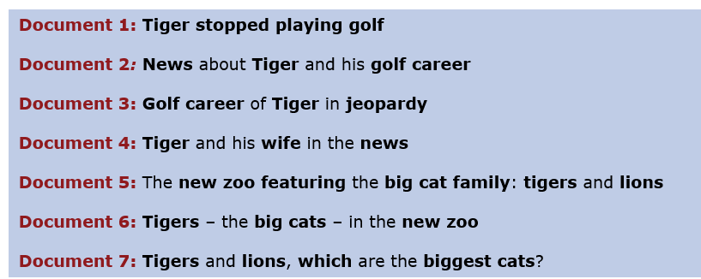
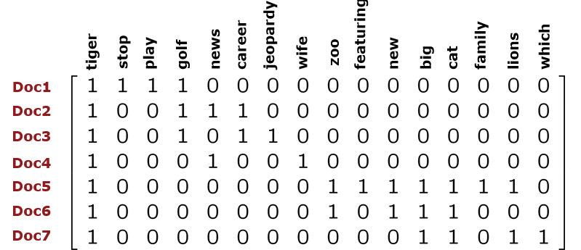
Exercise 3: Text Mining
Given the following document-term matrix, find the related documents and what they
are about.
load exercise3_docterm.mat
Compute its SVD
Which group does this document belong to?
Document 8: Tiger back to golf

Slide 4
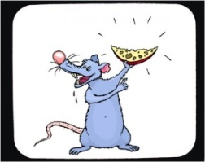

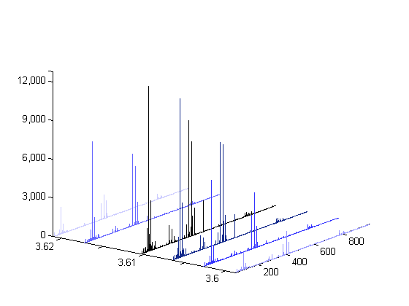

Exercise 4: Metabolomics
Some are fed with 10g apple while
some are controls (no apple)
Liquid Chromatography-
Mass Spectrometry (LC-MS)
features
samples
load exercise4_metabolomics.mat
Preprocess the data
Plot singular values
Compute the best rank-r approximation that represents the 80% of the “energy”
Can you group the samples based on apple consumption (Class1:10g apple, Class2: no apple)?

Slide 5
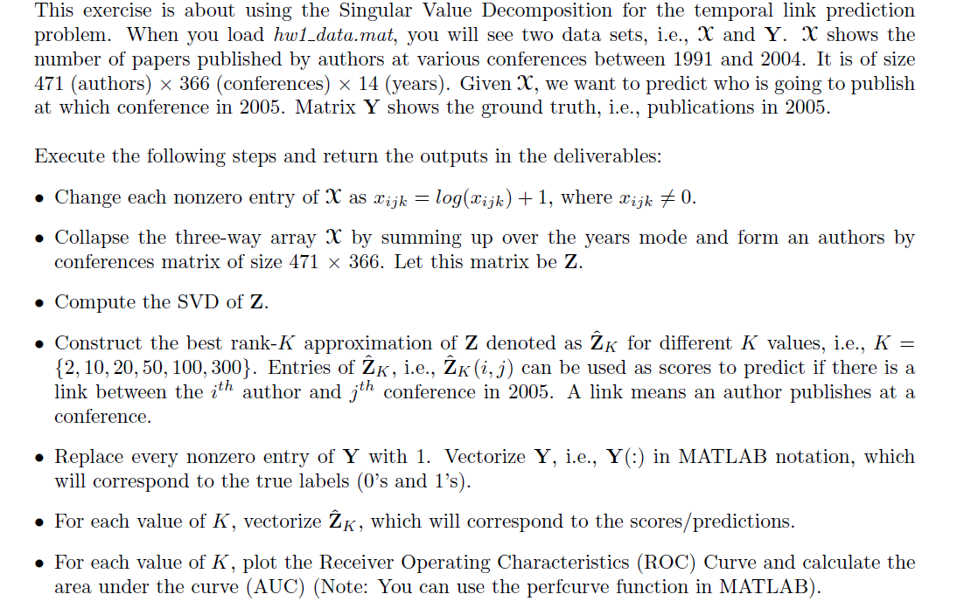
Exercise 5: Link Prediction using the DBLP data

Slide 6
Exercise 6: Solving Least Squares using SVD

